Slide 1
Predicting sales success from INTRO callS
Mikiko Bazeley
March 2019
Springboard Data Science Cohort
GH: https://github.com/MMBazel/springboard-program/tree/master/capstone1

Slide 2
Contents
I. Background
II. Description of Data Set
III. Data Exploration
IV. Data Analysis
V. Predictive Models
VI. Recommendations & Future Work
A1. Appendix: Additional Resources
A2. Appendix: About Me

Slide 3
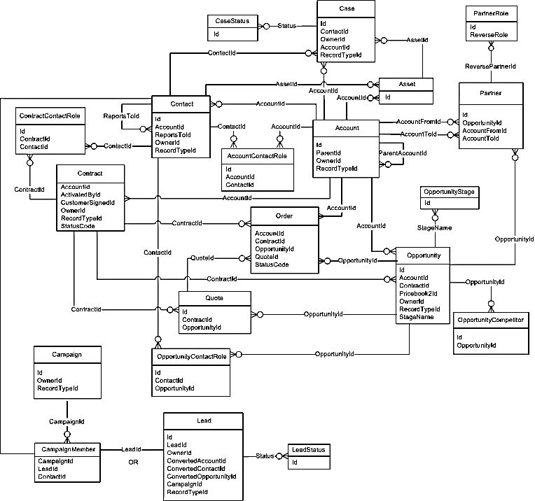
I. Background + II. data Set description
Notes:
Consider talking about:
Pre-processing
Data mining
Results validation

Slide 4
I. Project Background
Context:
Goals:
This project is focused on understanding what are the drivers for demo call qualifications and whether we can create a robust predictive model.
Two data sets are utilized (both internal and derived from the company's Redshift data warehouse) focused on leads and "intro calls" (demo calls). The data warehouse collects the data from Salesforce and processes it via ETL but still requires intense data cleansing and wrangling.
Of the 107 variables in the initial lead dataset and 114 variables in the intro call data set, we'll be focusing on the core variables that relate to the demo calls. Demo calls (or intro calls, term are synonymous) occur after a lead has entered the system and before an opportunity can be created. As a result, predicting the outcome of demo calls (which are hosted by a live person and subjective) can be a tricky judgement call
Being able to classify whether an intro calls will be qualified based on lead characteristics helps create consistency and transparency for both forecasting and training.
1) Determine if correlations between key sales indicators (account level demographics, lead characteristics, etc) and qualification outcome.
2) Determine if there a statistically significant difference between qualified and disqualified intro calls in regards to key characteristics.
3) Create machine learning model that allows us to predict whether an intro call will be qualified and understand the different drivers of qualification across models.

Slide 5
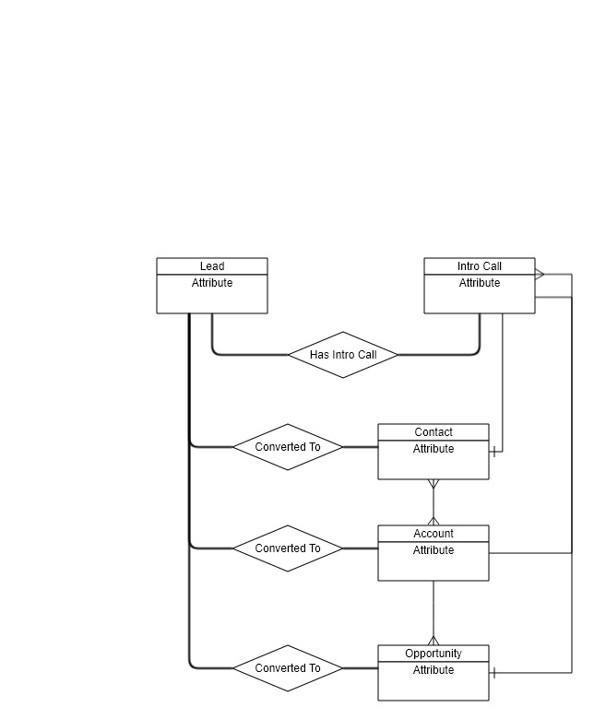
II. Detailed Data Set Description
Datasets
Origin: AWS Redshift Database that collects data from all areas of the company (Salesforce, ADP, JIRA, Google Analytics, etc)
Leads:
Volume: ~50K
Columns: ~107
Examples: id, name, title, converteddate
Intro Calls:
Volume: ~23K
Columns: 114
Examples: lastactivitydate, name, systemmodstamp

Slide 6
III. Data Exploration + IV. Analysis
Data Exploration:
Volume Over Time
Lead Marketing Channel
Customer Types
Lead Countries
Landing Pages
Analysis:
Lead Score vs. Intro Call Qualification
Total Calls & Emails vs. Intro Call Qualification
Lead Intro Call Delta vs. Intro Call Qualification

Slide 7
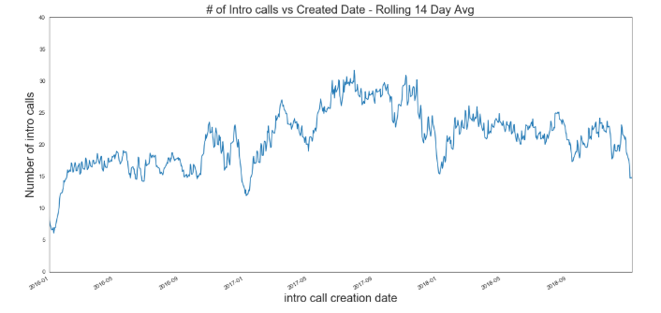
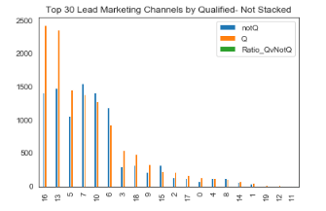
Data Exploration 1: Trends in Volume & Traffic Channels
Intro Calls Volume Over Time
Traffic Channels (Qualified vs. Not Qualified)
Of 22.9K records, 12.8K (56%) were qualified vs 10K (44%) disqualified.
The first graph below shows the volume of intro calls (min: ~ 0, high: ~50) versus their creation date (from Jan 2016 to Dec 2018).
One interesting trend to note is that there seems to be a higher volume of closed intro calls between May 2017 and Jan 2018.
Note how some traffic channels have a much higher proportion of qualified intro calls.
For example, lead source 3 & 0 (corresponding to “Brand” and “Affiliate”) have a ratio of 1.9 but are in sixth place and up, with additional intro call sources in between having a ratio of around 0.8~1.6.

Slide 8
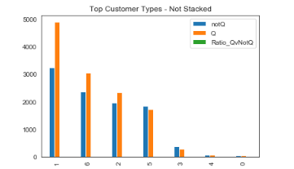
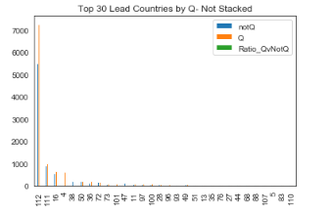
Data Exploration 2: Trends in Customer Types & Countries
Customer Type (Qualified vs. Not Qualified)
Countries (Qualified vs. Not Qualified)
After generating the following charts, it seems that customer type could be a driver (as well as an indicator of the company’s strategic focus on the enterprise space).
1 corresponds to ‘Enterprise’ (2 is ‘Unknown’, which doesn’t exactly bode the best in terms of our data quality) and 4 corresponds to ‘Nonprofits’ (which makes sense, the company primarily markets to companies willing to invest significant resources in onboarding and digital adoption).
Countries is a little surprising as we have some EMEA and ANZ/APAC countries listed as the top producers of qualified intro calls. The company started in Israel and has major presence in AMER but it’s interesting to see the UK (#111), Australia (#4), and Germany (#38) up in the top 8.

Slide 9
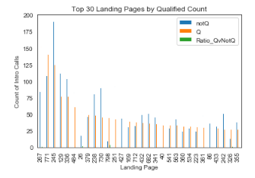
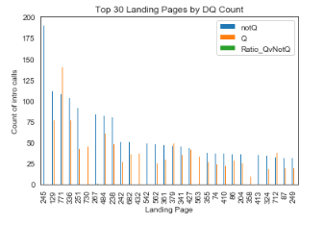
Data Exploration 3: Trends in Landing Pages (Qualified vs. Not Qualified)
Qualified
Not Qualified
When we look at landing pages and try to create top 30 charts, we see some interesting trends where the top 30 best landing pages by qualified count aren’t the same as the top 30 landing pages by ratio of qualified to disqualified intro calls

Slide 10
Data Analysis Takeaways
Variables as potential candidates for drivers of intro call status:
Landing Page
Lead/Marketing Channel
Customer Type
Creation Date
Potential Mixed Results:
Lead Score
Intro Call - Lead Creation Delta
Region
Need to test for meaningful differences between qualified & disqualified intro calls:
Lead Score
Intro Call - Lead Creation Delta
Total Calls/Emails

Slide 11
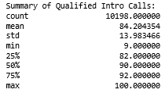
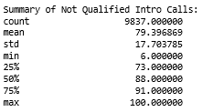
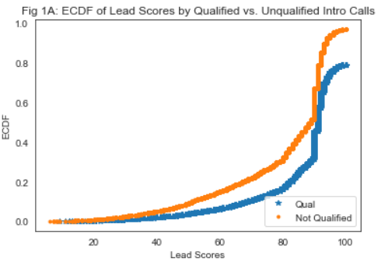
Lead Score vs. Intro Call Qualification
Quality of lead can continue to impact downstream qualification & sales process beyond the Marketing to Sales Handoff , with lead scores differing between Qual & Not Qual
We first want to understand the summary statistics of Qualified vs. Unqualified Intro Calls and whether the assertion that there is no difference (and lead scores should be 60+).
From printing the summary statistics, we can already see that the assertion that the sales team doesn’t interact with leads below 60 is false. Both samples of Qualified and Disqualified Intro Calls had a minimum below 60 (Qualified: 9, Disqualified: 6).
However our Qualified sample is displaying an IQR of [82 (25%), 92 (75%)] and our Disqualified sample is displaying an IQR of [73 (25%), 91 (75%)], so it’s possible the assertion that the majority of leads leading to demo calls should be around 70-90. We also observe a difference in means: Qualified (84), Unqualified (80).

Slide 12
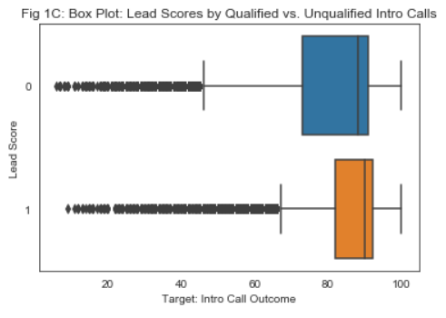
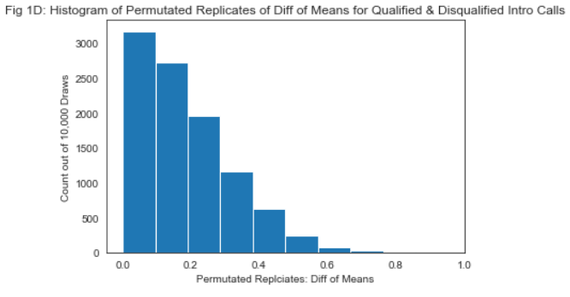
Lead Score vs. Intro Call Qualification
Quality of lead can continue to impact downstream qualification & sales process beyond the Marketing to Sales Handoff , with lead scores differing between Qual & Not Qual
Results of Statistical Tests:
Permutation Test:
Empirical Diff of Mean: 4.8 (compare to FIG 1D)
Proportion of replicates with value as great or greater than empirical diff of means - p-value = 0.0000
Reject null hypothesis that two variables have identical distrb.
Mann-Whitney:
statistic=41233671.0, pvalue=1.3146e-107
Welch’s T-Test:
statistic=21.23737118, pvalue=6.33e-99

Slide 13
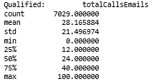
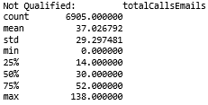
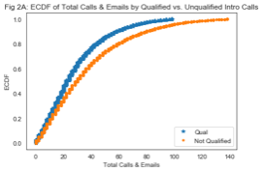
Total Calls & Emails vs. Intro Call Qualification
Level of engagement can be an important indicator of a qualified prospect & can show inefficiencies in engagements with not qualified prospects
In an ideal sales world, most sales managers would like sales reps to engage in the minimum amount of correspondence needed to: (1) qualify a prospect and (2) ensure good prospects are pulled into the sales process.
From printing the summary statistics, we can already see that Disqualified Intro Calls were associated with a higher mean of Total Calls & Emails compared to Qualified Intro Calls (36.9 vs. 28.0).
We can also see a difference in the IQR of Disqualified vs Qualified Intro Calls, indicating that prospects of Disqualified Intro Calls could be taking up more sales rep time (Qualified: [12 (25%), 40 (75%)], Disqualified: [14 (25%), 52 (75%)]). ]

Slide 14
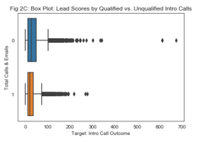
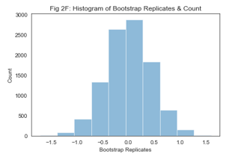
Total Calls & Emails vs. Intro Call Qualification
Level of engagement can be an important indicator of a qualified prospect & can show inefficiencies in engagements with not qualified prospects
Results of Statistical Tests:
Bootstrap:
Empirical Diff of Mean: 8.845
Proportion of replicates with value as great or greater than empirical diff of means - p-value = 0.0000
Reject null hypothesis that two variables are same but come from difft groups.
Mann-Whitney:
statistic=20558854.5 , pvalue=1.37e-57
Welch’s T-Test:
statistic=-20.2931374 , pvalue=3.96e-90

Slide 15
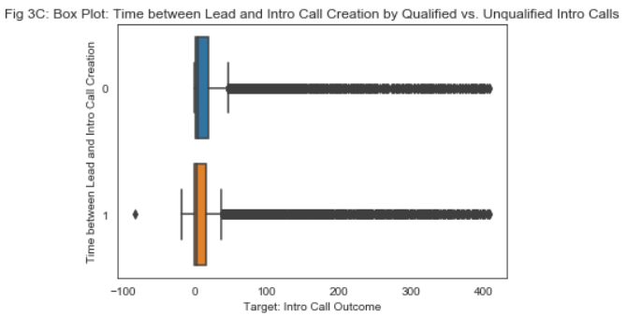
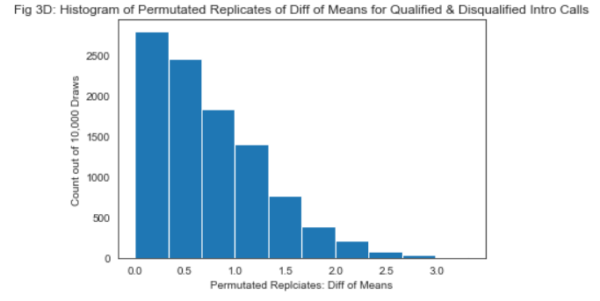
Lead Intro Call Delta vs. Intro Call Qualification
Freshness of Lead for Intro Call Doesn’t Seem to Impact Outcome
Results of Statistical Tests:
Permutation:
Empirical Diff of Mean: 1.29
Proportion of replicates with value as great or greater than empirical diff of means - p-value = 0.1572
[Fig 3D] From the histogram of permuted replicates we can visually see that the empirical mean of 1.5 isn’t an extreme value with about 12% of the permuted values having a value as great or greater than the empirical difference of means. The permutation test result doesn’t seem to provide evidence to reject the null hypothesis that Qualified and Disqualified Intro Calls are significantly different with regards to the Time Delta
Mann-Whitney:
statistic=32835127.0 , pvalue=1.586e-05
Welch’s T-Test:
statistic= 1.40082158, pvalue = 0.161
We are seeing conflicted results from the Mann-Whitney test (which seems to reject the null hypothesis that the populations are similar) and Welch’s T-Test (which doesn’t result in a statistically significant p-value).

Slide 16
V. Predictive Models
Prediction, hyperparameter tuning and model performance evaluation of:
Logistic Regression
Random Forest
Gradient Boosted

Slide 17
Predictive Models overview
Process:
Prepare master data set (1-Hot Encoding)
Scale data (StandardScaler)
Train-Test-Split data
Evaluate
Tune parameters using RandomizedSearchCV & GridSearchCV
Evaluate
My goal was to understand what features were important to predicting whether an intro call would be qualified. In order to classify whether intro calls would be classified, I initially built three models: a logistic regression model, a random forests model, and a gradient boosted model.
Leveraging different feature engineering techniques and hyperparameter tuning, I was able to attain 79.3 % accuracy in classifying Intro Call qualifications (table of results shown below) with the Gradient Boosted 1-Hot Encoded Model with Hyperparameter tuning.
The top 5 features across all three models in determining Intro Call Qualification Status included:
inferScore___Lead_AddedInfo
totalEMails___Lead_AddedInfo
totalCalls___Lead_AddedInfo
introCallCreated_leadCreated_delta
assignedToRole___IntroCall_OtherInfo_map
The features I assumed would be highly ranked but weren’t included:
country___Lead_LeadCompanyInformation_map
trafficChannel___Lead_MarketingInformation_map_map
product2___IntroCall_MeetingDetails_WalkMe

Slide 18
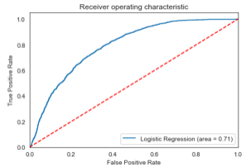
Model 1: Logistic Regression
Model Performance & Features
Features:
Before tuning accuracy:
Accuracy Score: 0.73
With GridSearchCV:
Best parameter: {'C': 10, 'max_iter': 100}
Best score: 0.75
Test set accuracy: 0.73
Logistic model performed the worst of all three at classifying intro call qualifications. Additional parameter tuning provided no significant lift.

Slide 19
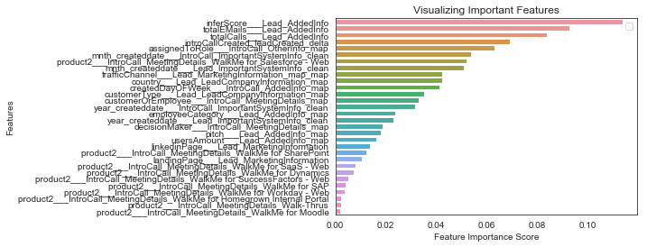
Model 2: Random Forest
Model Performance & Features
Before tuning:
Accuracy Score: 0.74
Precision & Recall (0): 0.70 | 0.72
Precision & Recall (1): 0.78 | 0.75
Random Forest might suffer from overfitting (see Confusion Matrix on Train Set) – Random Forest accuracy was #2 of all models
Interestingly we see that Lead Score is the top ranked feature, potentially supporting the hypothesis that Lead Score can still be relevant up the sales funnel past the Marketing-Sales hand off.
Top Features | Importance
inferScore___Lead_AddedInfo | 11%
totalCalls___Lead_AddedInfo | 9%
totalEMails___Lead_AddedInfo | 9%
introCallCreated_leadCreated_delta | 7%
assignedToRole___IntroCall_OtherInfo_map | 6%
Test Set | Predicted: Yes | Predicted: No
Positive | TP 2804 | FN 920
Negative | FP 810 | TN 2129
Train Set | Predicted: Yes | Predicted: No
Positive | TP 8529 | FN 91
Negative | FP 53 | TN 6873

Slide 20
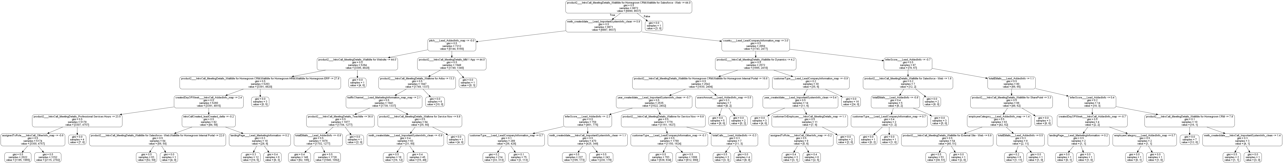
Model 2: Random Forest
Model Performance & Features
After tuning:
Best parameter: {'bootstrap': False, 'max_depth': 60, 'max_features': 'sqrt', 'min_samples_leaf': 1, 'min_samples_split': 13, 'n_estimators': 400}
Best score: 0.79
Test set accuracy: 0.79
Through optimizing tuning parameters was able to get 5% lift in accuracy of model predictions. Image below visualizes the first 6 levels of tree depth for the random forest classifier.

Slide 21
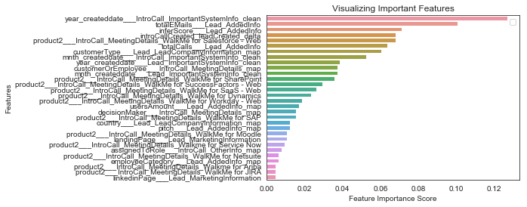
Model 3: Gradient Boosted
Model Performance & Features
Before tuning:
Accuracy Score: 0.78
Test Set | Predicted: Yes | Predicted: No
Positive | TP 3254 | FN 432
Negative | FP 1053 | TN 1924
Train Set | Predicted: Yes | Predicted: No
Positive | TP 7738 | FN 920
Negative | FP 2428 | TN 4460
With GridSearchCV:
Best parameter: {'colsample_bytree': 1.0, 'gamma': 2, 'max_depth': 6, 'min_child_weight': 8, 'subsample': 1.0}
Best score: 0.78
Test set accuracy: 0.798
Top Features | Importance
totalEMails___Lead_AddedInfo | 11%
introCallCreated_leadCreated_delta | 8%
customerType___Lead_LeadCompanyInformation_map | 8%
inferScore___Lead_AddedInfo | 7%
year_createddate___IntroCall_ImportantSystemInfo_clean | 7%

Slide 22
VI. Recommendations + Future Work
Project Based-Recommendations
Future Work
General Recommendations
Notes:
Consider talking about:
Pre-processing
Data mining
Results validation

Slide 23
VI. Project Based Recommendations + Future Work
Recommendations
Future Work
Given that disqualified intro calls were correlated with higher calls & emails, one possible suggestion could be to train the sales teams to front load discovery questions for earlier disqualification.
Given also the difference in distributions of lead scores by qualified vs. disqualified, there could be down stream impact from marketing letting in poorer quality leads. Some of their assertions should also be evaluated as it seems their leads aren’t as high quality as expected.
Using the model building process developed in this project, working with the sales org to ask similar questions:
Can we predict what deals will close?
Can we predict which existing customers are candidates for upsell/cross sell?
How can we utilize the insights from both the intro call qualification process to improve internal processes around data collection?
Once these labels are predicted, how can we then improve our forecasts?

Slide 24
VI. General Recommendations
For Similar Projects
For the Organization
Never assume you have as much data as you think you do! Of 200+ fields “available” for analysis a majority ended up being duplicates or poorly populated. ~15 were used for model building across models.
Don’t assume that just because you have a “data warehouse”, its contents are relevant and useful.
Gantt charts are still around for a reason. Plan ahead as much as possible and under promise!
Create tighter communication with upstream application teams
Constant re-evaluation and assessment of data points being collected should be done
Significant data cleaning and extraction time could have been saved by the presence of relevant documentation, especially around data owners.

Slide 25
A1. Appendix: Additional Resources
Project Page:
List of resources (& links) used for the project: https://bit.ly/2T0kmxC
Project Repo:
Jupyter notebook:
Supporting Documentation:
Presentation deck:
Springboard Program:
Information about program: https://www.springboard.com/workshops/data-science-career-track/

Slide 26
A2. Appendix: About me
Applied analytics and data science evangelist, Mikiko Bazeley is a seasoned analyst with 5+ years of working in high-impact roles for start-ups and enterprise tech companies.
A UCSD Economics & Anthropology graduate, Mikiko aims to use her experience in social research & modeling to strategically leverage data science in order to drive new insights for sales, marketing, finance & customer success organizations. Mikiko is also GIS & Supply Chain Management certified.
Prior to joining WalkMe (where she focuses on scaling data science & global sales analytics) Mikiko worked as a Data Scientist at Autodesk (focused on understanding product adoption & user health), as well as assisting with scaling strategic finance initiatives at Sunrun (the largest residential solar company in the US).
Please feel free to reach out:
LinkedIn: https://www.linkedin.com/in/mikikobazeley/
Email: mmbazel (at) gmail (dot) com

Slide 27
Thanks!

